Slide 1
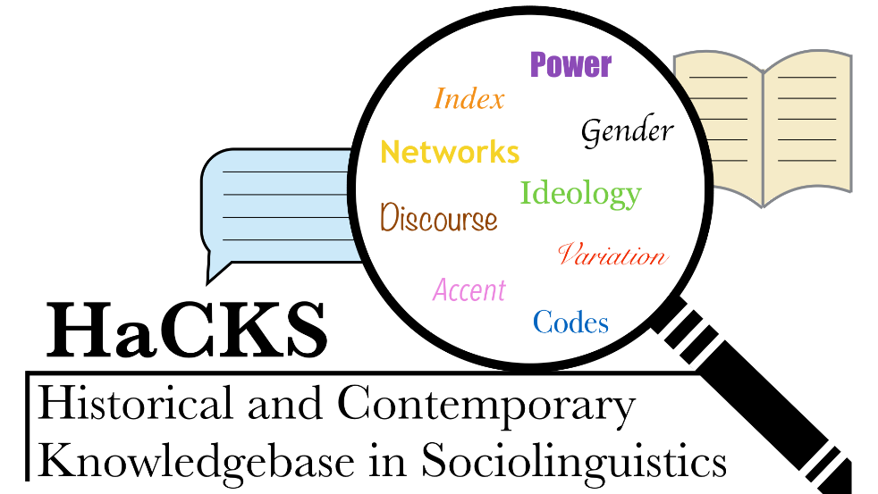
HaCKS Workshop Indexicality and Sociolinguistics @ University of York
A full day’s worth of talks and presentations on contemporary sociolinguistics and its interfaces featuring members of the Department of Language and Linguistic Science as well as participants from Sheffield and Leeds
Thursday 28th February 2019
Bowland Auditorium in Berrick Saul Building (1045-1245) and James College (J/P/002) (1330-1530)
A must-attend for sociolinguists!
hacksocioling.com
hacksocioling@wrocah.ac.uk
Proudly sponsored by WRoCAH and AHRC for 2018/2019
@hacksocioling
hacksocioling

