Slide 1
Chinese cleft constructions Microparametric ‘lateral’ grammaticalization: where formal syntax and sociolinguistics meet
Keith Tse (University of York/Ronin Institute)
keith.tse@alumni.york.ac.uk
HaCKS (Historical and Contemporary Knowledgebase on Sociolinguistics) Workshop
28th February 2019

Slide 2
Introduction: bio, bits and pieces
Keith Tse (2014-2017): Master’s by Research (MRes)
Grammaticalization and ‘lateral’ grammaticalization: new perspectives on linguistic interfaces and functional categories (White Rose depository: http://etheses.whiterose.ac.uk/15691/)
‘Lateral’ grammaticalization (Simpson and Wu (S&W) (2002))
Chinese cleft constructions (shi-de): de is reanalyzed ‘laterally’ from the nominal to the clausal domain (Minimalist/cartographic/functional categories on the nominal and clausal spines (Cinque, Rizzi, Abney))

Slide 3
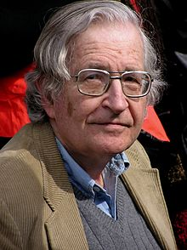
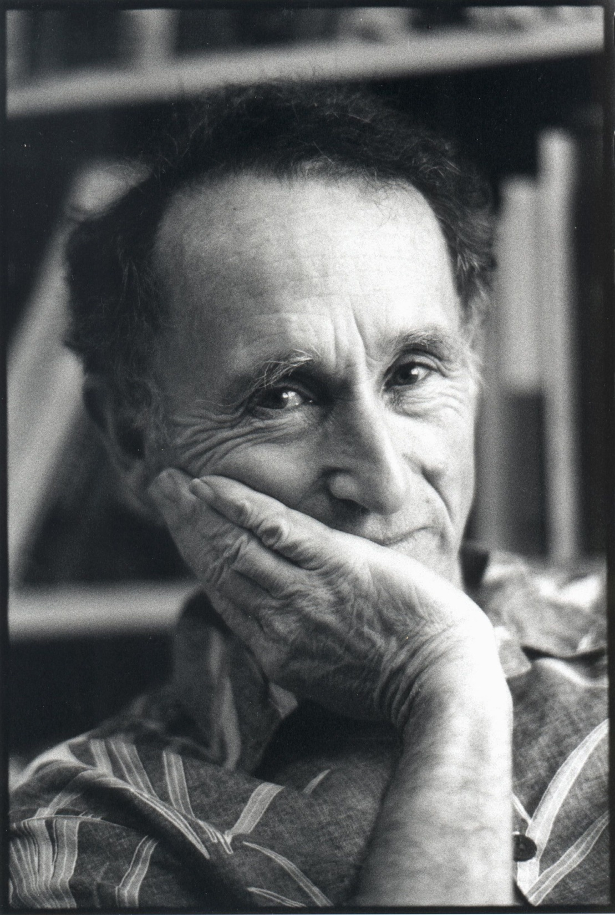
Reconciling formal syntax and sociolinguistics
Formal (Minimalism/Chomskyan) syntax : sociolinguistics (Labov)
Friends or foes?

Slide 4
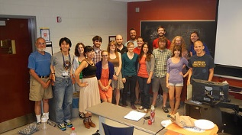
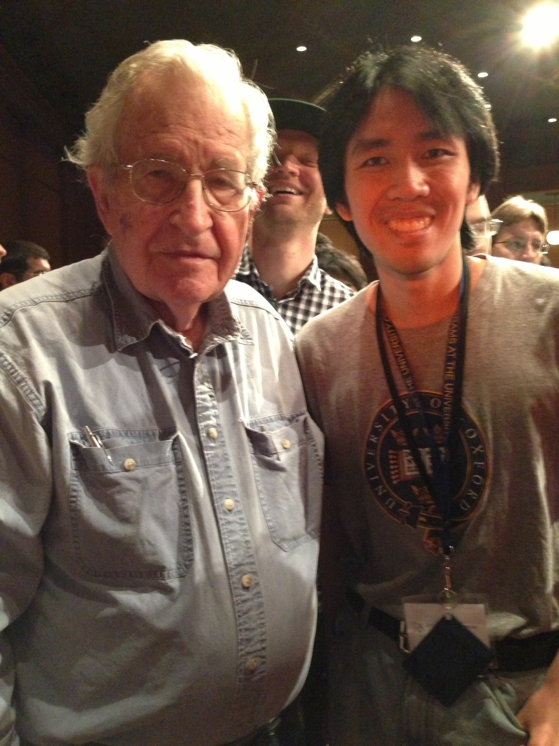
Linguistics Society of America Summer Institute 2013 (University of Michigan, Ann Arbor)
‘Sentences and the Social: Representing Syntactic Variation’
(Professor Julie Boland (UMich) and Dr Lauren Squires (Ohio State University)

Slide 5
Formal variationist linguistics
Kroch (1989): (following Bailey) S-curve where old and new linguistic forms co-exist through time
Roberts (2010): ‘lexical splits’ in grammaticalization (lexical > functional > more functional) where old and new forms co-exist synchronically (cf microparameters/nanoparameters (lexical))
Language Variation and Change (LVC) (new vs old linguistic forms) modelled within formal (micro-)parametric syntax
Language Actuation (Weinreich, Labov, Herzog): probabilistic rather than deterministic (contra Strong Minimalist Thesis (SMT) which states that language acquisition is formally deterministic (‘simplicity’)?)

Slide 6
Chinese cleft (shi-de 是…的) constructions
Chinese cleft constructions (copula shi + adnominaliser de) (Mandarin)
Subject shi cleft-focus (adjacent) cleft-presupposition de
(Lee (2005), Paul and Whitman (2008), Hole (2011))
De- VOde/VdeO (northern dialects of Mandarin) (S&W (2002))
Wo shi zuotian mai piao de
I SHI yesterday buy ticket DE
‘It was yesterday that I bought the ticket.’
Wo shi zuotian mai de piao
I SHI yesterday buy DE ticket
‘It was yesterday that I bought the ticket.’
(Simpson and Wu (S&W) (2002:169))
*VgeO (southern dialects have ge)
*zoengsaam hai kamjat
Name COP yesterday
daa ge dinbo
Send GE telegram
‘It was yesterday that Zoengsaam
sent the telegram.’ (Cantonese, Lee and Yiu (1998:11), cf Tang (2011))
(VdeO) northern variant (unknown to me, a southerner)

Slide 7
Chinese dialectal cleft (COP + SFP) constructions
Chinese cleft constructions (copula + clausal particle (SFP) de/ge)
Cross-linguistically cleft constructions are very often formed with the copula assigning focus to the adjacent element in its relative clause complement (cf it-clefts).
Shi-de:
Wo shi ZUOTIAN mai piao de
SUBJ COP cleft-focus cleft-presupposition (Hole and Zimmermann (2013:306))
It-cleft:
It was CLINTON who won.
PRO COP cleft-focus cleft-presupposition (Hedberg (2000:891)
Cleft constructions are in essence copular (Heycock and Kroch (1994))

Slide 8
Chinese dialectal cleft (COP + SFP) constructions (2)
Subject shi focus (adjacent) presupposition de/ge
ge- VOge/*VgeO
De- VOde/VdeO
Null hypothesis: de/ge are categorically the same (adnominaliser (possessive))
Nominal > clausal (‘lateral’ grammaticalization (S&W (2002))
Argument: de/ge are different due to discrepancy between VdeO and *VgeO
De (n) / ge (CL): different types of ‘lateral’ grammaticalization (nominal > clausal where ge, in difference to de, pre-empts *VgeO
De (的) < Medieval Chinese 底 ‘bottom’ (< Classical Chinese nominaliser 者) (Lu (1943), Cao (1999), Liu (2008)) (n > D) (Aldridge (2008), Yap (2010))
Ge (嘅) < Classifier 個 (<Classical Chinese 棝/固 ‘bamboo’) (Bisang (2012), Cao (1999)) (CL > D)

Slide 9
Derivation of Chinese cleft constructions (VOde/VOge)
PredP
SpecPred Pred’
(Subject) Pred FocP
shi SpecFoc Foc’
[u-foc]subject Foc CP
adverb [i-foc] SpecC C’
verb TP i C TP
TP SpecT T’ de/ge t i
T VP
V’
V DP
Shi is a copula verb assiging cleft-focus
Cleft-focus derived via A’-movement and both narrow and broad foci are permitted (Paul and Whitman (2008))
de and ge are analysed as SFPs which are sentence-final

Slide 10
Derivation of Chinese cleft constructions (VdeO)
PredP
SpecPred Pred’
(Subject) Pred FocP
shi SpecFoc Foc’
[u-foc]subject Foc TP
adverb [i-foc] SpecT T’
T(past) vP
(de) v’
v VP
V i-de V’
V-*ge V DP
t i
Shi is a copula verb assiging cleft-focus
Cleft-focus derived via A’-movement and only narrow focus is permitted (Paul and Whitman (2008))
de is affixed onto the verb as a past-tense marker while ge cannot

Slide 11
Formation of Chinese cleft constructions (nominal > clausal) (‘lateral’)
Recent analyses propose that VOde and VdeO are derived from two different types of relative clauses (VOde/VdeO) (Long and Xiao (2009, 2011), Han (2012), Zhan (2012), Long (2013)).
East Asian relative clauses tend to be nominalized by nominal particles (Chinese de/ge, Japanese no etc) (Yap, Grunow-Harsta and Wrona (2011))
Following Aldridge (2006, 2008), early di (< Classical Chinese zhe) is lower than zhi (D) and tends to be phrase-final, which suggests that di/zhe is a nominaliser (n), which is reanalyzed as an adnominaliser de in a slightly higher position on the nominal cline (D) (n > Mod) (Yap (2010, 2012), cf Paul (2012, 2015), following Rubin (2003))
Ge, on the other hand, is reanalyzed from an original classifier (CL) to an adnominaliser (D) (CL > D) (Cao (1999))
CLP
CL ModP
ge Mod nP
de/ge n NP di

Slide 12
Formation of Chinese cleft constructions (nominal > clausal) (‘lateral’) (2)
DP
D NumP
Num ClassifierP
Classifier (CL) ModP
ge (+D)
Mod nP
de (+/-D)
n NP
di (< zhe)
N
CP
C TP
VOde/VOge
T AUXP
AUX AspP
Asp vP
v VP
VdeO/*VgeO
V

Slide 13
VOde / VOge
VOde/VOge is derived since both de and ge lose nominal characteristics in sentence-final position where there is no overt nominal complement
非 是 菩薩 行藏
NEG COP divine.beings behaviour
此 是 俗門 做 底
This COP laymen do DI
‘It is not the behaviour of divine beings; this is the doings of laymen’ > ‘… it was laymen who did this.’
(敦煌變文記)
人人 盡 有 底 衣 即 是…
everyone all have DI clothes then COP
既 是 人人 盡 有 底， 用 被 做 什摩?
as COP everyone all have DI use cover do what
‘The clothes which everyone has it is then’… ‘If it is the clothes which everyone has (> it is the case that everyone has it), what use is there for cover?’ (祖堂集)
明 明 個， 明 明 個… 既 是 明 明 個,
Bright bright GE bright bright GE as COP bright bright GE
爲 個 摩 頭 在 裏 許?
For GE what head in inside within
‘The bright one, the bright one’… ‘If it is the bright one (> as it is bright), why is its head inside?’ (祖堂集)

Slide 14
VdeO / VgeO
那 兩 個 人 是 如此如此 這般這般 使 的 手段
those two CL people COP thus so use DE manipulation
‘As for those two people, it is the manipulation thus and so used’ > ‘… it was thus and so that those two people manipulated’ (元雜劇)
娘 原 是 氣惱-上 起 的 病
Mother originally COP angry-LOC become DE illness
‘As for mother, it was originally the illness contracted through anger.’ > ‘it was originally through anger that my mother contracted the illness.’ (元雜劇)
悟空， 你 是 哪 世 修來 的 緣法
Wukong you COP which life obtain-AFF DE enlightenment
‘Wukong, as for you, which life was it obtained from?’ > ‘… which life was it that you obtained enlightenment?’ (西游記)
則 是 茶坊-裏 見 個 粗-眉毛 大-眼睛… 的 客人
then COP tea.lounge-LOC see GE think-brow big-eye DE customer
‘Then it was in tealounge that he saw a customer with thick eyebrows and big eyes.’ (南宋話本選集)
VdeO is reanalysable since de does not have inherent definiteness and can select general/abstract nominal complements (shouduan ‘manipulation’, bing ‘sickness’, yuanfa ‘enlightenment’, whereas VgeO is not reanalysable since ge has definiteness and tends to select referential nominal complements (keren ‘customer’) which pre-empts its analysis as a clausal element.

Slide 15
‘Lateral’ grammaticalization parameterized (nominal > clausal)
DP
D NumP
Num ClassifierP
Classifier (CL) ModP
ge (+D)
Mod nP
de (+/-D)
n NP
di (< zhe)
N
CP
C TP
VOde/VOge
T AUXP
AUX AspP
Asp vP
v VP
VdeO/*VgeO
V
The inherent deixis of ge retains its nominal category and pre-empts ‘lateral’ grammaticalization

Slide 16
Appendix (possible counterexample)
In Xinhua dialect, there is apparently a counterexample of VgeO:
我 是 前年 到-個 北京
I COP two.years.ago arrive-GE Beijing
‘It was two years ago that I arrived at Beijing.’ (Wu (2005:279))
It could be dialectal interference with de since in Xiang dialects to which Xinhua belongs, de and ge are used almost interchangeably in many cognate constructions (Wu (2005:276ff))
Alternatively, one could entertain the possibility that ge can be reanalyzed as a verbal suffix when its definiteness is undermined.
卻 是 聖人 説 個 影子
But COP saint say GE shadow
‘But it was the shadow mentioned by saints’ > ‘but it was saints who mentioned shadow’ (definiteness of ge very weak here)

Slide 17
Acknowledgements
I would like to place special thanks to the University of York for funding and supporting my research, especially to my supervisors, Dr George Tsoulas, Professor Giuseppe Longobardi and Professor Peter Sells. Also, thanks to Professors Edith Aldridge, Alain Peyraube, Walter Bisang, Feng Sheng-Li and Stephen Matthews for providing me their expert opinion and advice on historical Chinese. 錯誤自負.

