Slide 1
Biolinguistic inquiries: what is ‘simplicity’?
Keith Tse (MCIL, CL) (M.A. Oxon (balliol), m.a. manc, m.res. Ebor, ronin, igdore)
6th NOVEMBER 2020
keith.tse@ronininstitute.org
My sincerest thanks to jon wilkins FOR inviting me to join the ronin institute in july 2018 and for EVERYTHING THAT HE HAS DONE FOR ME SINCE LIKE funding my academic activities, TO ARIKA VIRAPONGSE AND ALEX LANCASTER FOR ORGANSING This WEBINAR AND ADVERTISING SO THAT THE WHOLE WORLD KNOWS ABOUT IT. I MUST ALSO THANK MY academic SUPERVISORS AND MENTORS FOR SUPERVISING MY WORK On formal LINGUISTICS FROM WHICH THIS PRESENTATION IS BASED: Professor nigel Vincent at the university of Manchester, professor ian Roberts at the university of Cambridge, professors George tsoulas, Giuseppe longobardi and peter sells at the university of york. This presentation is also heavily indebted to the works on formal parameters by professors ian Roberts, Giuseppe longobardi, elly van gelderen, and, of course, the great Noam chomsky. I owe my immense gratitude to all the people above and all errors remain my own responsibility.

Slide 2
aims and goals: structure and roadmap
Public seminar for specialists and non-specialists in Linguistics
1) What is Linguistics? An introduction into the history and nature of Linguistics
2) What is Biolinguistics? The study of human languages in relation to other types of languages (non-human, machine, primates, animal etc)
3) What is formal ‘simplicity’? A pertinent and endlessly debated topic in formal linguistics (Chomskyan)
Aims:
1) You will be introduced to Linguistics and how it has developed as an academic discipline.
2) The nature of human language and its cognitive foundations
3) New (and old) perspectives on derivational ‘simplicity’

Slide 3
linguistics (what is it?)
Definition: ‘the scientific study of language and its structure including the study of morphology, syntax, phonetics and semantics…’ (Google Search, 5th November 2020)
Wikipedia, Oxford, Cambridge, Linguistic Society of America (LSA), Britannica, UCLA, UC Santa Cruz
‘the scientific study of language’ (common factor)
LINGUISTICS (19th century AD):
Neogrammarians noticed some regularity in the sound correspondences between Indo-European (IE) languages (Latin, Greek, Sanskrit etc).
Regularity in sound change
Traditional historical Indo-European linguistics (parent proto-language of all European and Indic languages) + evolution of sounds from Proto-Indo-European (PIE) to the various IE languages

Slide 4
(brief) history of linguistics (19th century ad till now)
Classical Philology (Rasmus Rask, Jacob Grimm, Karl Verner)
Latin, Greek, Sanskrit…
 | Latin | Greek | Sanskrit | Gothic (Germanic)
‘father’ | Pater | Pater | Pitar | fadar
‘three’ (3) | Tres | Treis | Trayas | threis
‘brother’ | Frater | Phrater | Bhratar | brothar
Latin /p/ : Greek /p/ : Sanskrit /p/ : Gothic /f/ > PIE /p/
Latin /fr/ : Greek /phr/ : Sanskrit /bhr/ : Gothic /br/ > PIE /bh/ + /r/
Latin /tr/ : Greek /tr/: Sanskrit /tr/ : Gothic /thr/ > PIE /t/ + /r/
PIE /p/ > Latin /p/, Greek /p/, Sanskrit /p/, Gothic /f/
PIE /bh/ > Latin /fr/, Greek /ph/, Sanskrit /bh/, Gothic /b/
PIE /t/ > Latin /t/, Greek /t/, Sanskrit /t/, Gothic /th/

Slide 5
20th century movements
Ferdinand de Saussure (1857-1913): ‘father of modern linguistics
langue (‘language’) vs parole (‘word’) / synchrony vs diachrony
Leonard Bloomfield (1887-1949): structuralism (language as a system)
Joseph Greenberg (1915-2001): language typology and genetic linguistics
William Labov (1927-): sociolinguistics and language use
Noam Chomsky (1928-): ‘cognitive revolution’ in linguistics

Slide 6
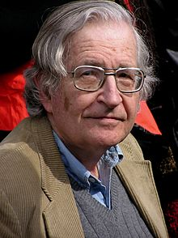
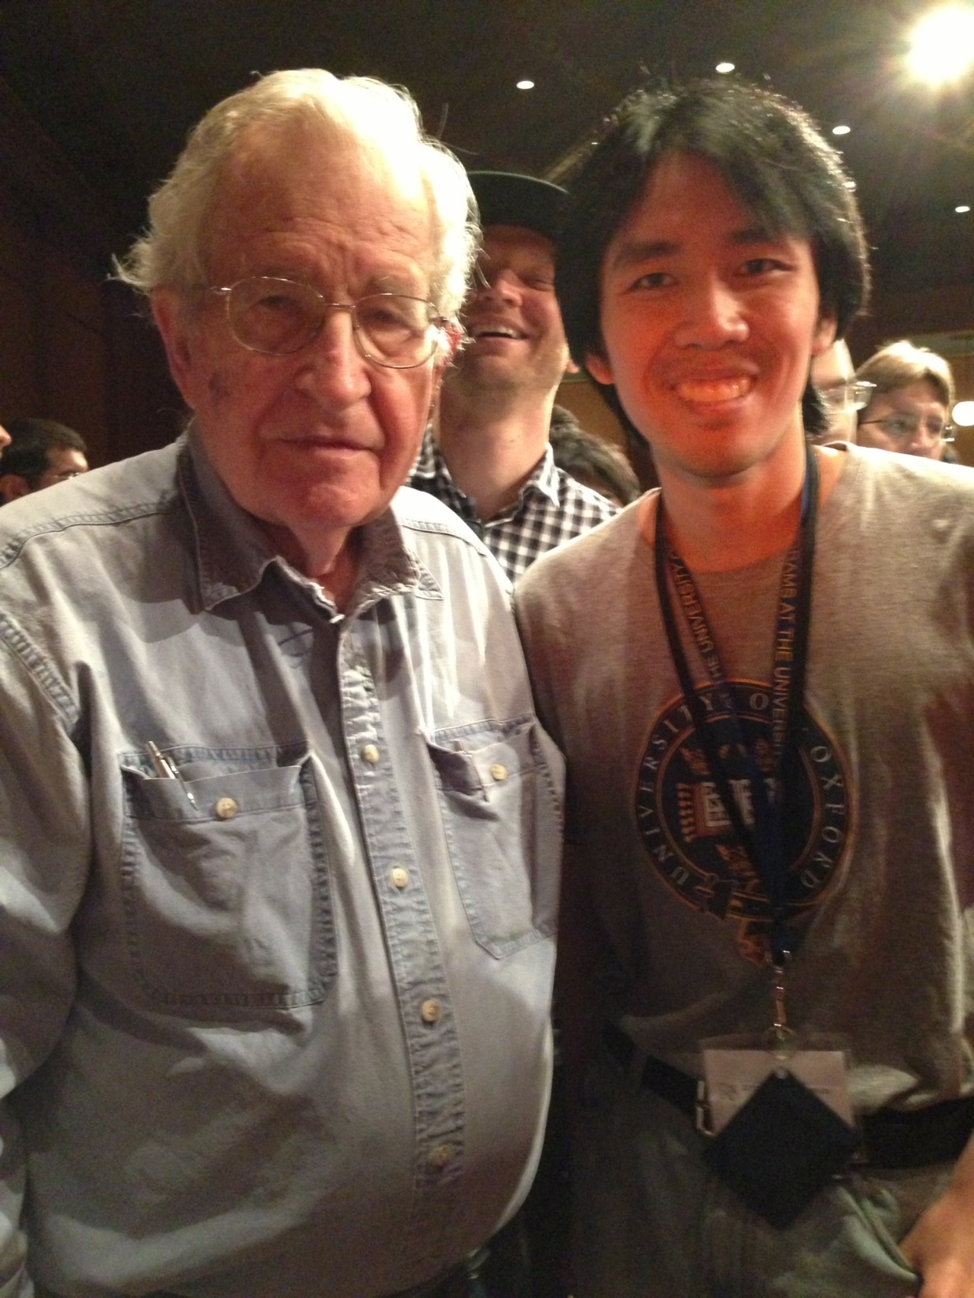
Noam Chomsky (1928-)
Great man (politics + academia (linguistics)
Linguistic Society of America Summer Institute 2013, University of Michigan, Ann Arbor, Michigan, United States of America, 23rd August 2013.
Peck, James (1987): The Chomsky Reader. Pantheon E Books.
McGilvray, James (2007): The Cambridge Companion to Chomsky. Cambridge University Press.
Antony, Louise and Hornstein, Norbert (2003): Chomsky and His Critics. Blackwell Publishing.

Slide 7
Chomsky the linguist
Cognitive revolution (Lightfoot, Epstein)
Universal Grammar (UG): biological component in language processing which is species-specific
Human language is species-specific: no other type of species is capable of doing THIS:
Reading/listening (audience i.e. you (I hope…)), writing/speaking (me)
FOXP2 gene
Chomsky, Hauser, Berwick (2002): language faculty in the broad sense (LFB)
language faculty in the narrow sense (LFN)
Scientific modelling of linguistic data (Chomsky (1957))
‘Simplicity’ (Occam’s Razor):
Ontological Minimalism vs Methodological Minimalism (Martin and Uriagereka (2000))

Slide 8
Biolinguistics
Lennenberg (1967): Biological Foundations of Language
Noam Chomsky: cognitive revolution:
human language is part of a biological organ
Human language is species-specific: no other type of species is capable of doing THIS:
Reading/listening (audience i.e. you (I hope…)), writing/speaking (me)
FOXP2 gene
Chomsky, Hauser, Berwick (2002): language faculty in the broad sense (LFB)
language faculty in the narrow sense (LFN)
language variation and change
language is a biological phenomenon
Traditional historical Indo-European linguistics (parent proto-language of all European and Indic languages
Language acquisition and change modelled within biological assumptions and premises (biolinguistics)
bridge between traditional language studies and modern linguistics

Slide 9
Language acquisition: Analytical triplet (lightfoot (1991, 1999))
First language (L1) acquisition and language change (UG pre-exists in a normal human brain from birth)
Universal Grammar (UG) + Primary Linguistic Data (PLD) -> Internal Grammar (I-G) (Lightfoot (1991, 1999, 2006))
UG consists of universal principles of human language (e.g. verbs, arguments, grammatical relations, consonants, vowels...)
Linguistic ‘cues’ in language acquisition i.e. what the infant hears/perceives
I-G is distinguished from External Grammar(E-G):
Linguistic competence (I-G), linguistic performance (E-G)
What you know vs what you do (speak/write/listen/read)
UG + PLD + Third Factor Principles (III) -> I-G (Chomsky (2005, 2007)) (more below)
General cognitive non-linguistic principles

Slide 10
Formalisation of language
Formalisation of linguistic data:
Indo-European comparative method
Saussurean/Bloomfieldian structuralism; Greenbergian typological universals
Chomsky: Transformational Grammar ( TG)
Other grammatical models: Lexical-Functional Grammar (LFG), Head Phrase-Driven Grammar (HPSG), Construction Grammar (CG)
Chomskyan linguistics:
TRANSFORMATIONAL GRAMMAR (TG) (transformations)

Slide 11
Chomskyan linguistics: a powerful journey
The Logical Structure of Linguistic Theory (1955); Syntactic Structures (1957)
Aspect of theory of Phrase Structure:
Lectures on Government and Binding (GB) (1981); Some Concepts and Consequences of the theory of Government and Binding (1982):
Deep Structure (DS) > (transformations) > Surface Structure (SS)
Principles and Parameters (P&P) (1980s)
Early Minimalism: Minimalist Inquiries (MI) (Chomsky (2000)), Derivation by Phase (DoP) (Chomsky (2001))
Minimalist Program (MP): program, not a theory, of P&P
Minimalist Program (1995) (cf Chomsky (1991, 1992, 1993))
Later and current Minimalism: Beyond Explanatory Adequacy (Chomsky (2004)), Chomsky (2005, 2007, 2008), Principles of Projection (PoP) (Chomsky (2013, 2015))

Slide 12
Linguistic Interfaces: derivation and spell-out
Syntax as derivational (transformational grammar (Chomsky (1955, 1965))
Deep Structure (DS) -> Surface Structure (SS)
Thematic structure (argument/event structure) created via Projection Principles (Merge)
Abstract and morphological Case is assigned (Move/Agree)
Derivation/Transformation -> Spell-Out
Rule-based (Transformation: Top-down; derivation: Bottom-up)
Phonetic Form (PF) and Logical Form (LG): syntax meets sound and meaning

Slide 13
Architecture of grammar: linguistic interfaces and spell-out
T-model/inverted Y-model:
DS
SS
PF LF
DS -> SS now superseded by Phase-by-Phase derivation (bottom-up derivational junctures known as Phases)
PF (PHON) contains Articulatory-Perceptual constraints
LF (SEM): Conceptual-Intentional

Slide 14
Functional categories
In P&P/MP (current model), functional categories (FCs) are paramount.
Traditional grammatical properties given structural representation:
Verb: Tense, Aspect, Mood, Subject-Agreement, Object-Agreement
Noun: Definiteness, Number, Gender,
Clause: Force, Focus, Topic…
‘functional categories constitute grammar…’ (Ouhalla (1991), cf Chomsky (1986))
Controversies: not everyone agrees:

Slide 15
Cartography of functional categories
In P&P (current model), functional categories (FCs) are paramount.
Traditional grammatical properties given structural representation:
Verb: Tense, Aspect, Mood, Subject-Agreement, Object-Agreement
Noun: Definiteness, Number, Gender, Agreement
Clause: Force, Focus, Topic,
English passivisation (Chomsky (1981)):
The professor praised the student >
TRANSFORMATIONS
{ } praised the student > (subject-deletion)
The student was praised (by the professor) (object-raising)

Slide 16
Parameters in p&p
Linguistic variation: language universals + language differences
Historical-comparative
Parameters (‘switches’ for each linguistic property):
Null subject parameter (Rizzi (1982)): Italian (Western Romance) vs English
Verb-object word order: VO, OV (Travis (1984)) (head-initial languages vs head-final languages)
Parameters encoded in Functional Categories (Borer (1984), Chomsky (1995), Biberauer (2008) etc; see the Cambridge Comparative Syntax Projects)
Functional categories are syntactic : syntactic operations (Merge, Move, Agree…)
Parametric variation lies in how functional categories are realized (F(Merge), F(Agree), F(Move) etc))

Slide 17
Minimalism
Minimalist Program (MP) (Chomsky (1995)): latest version of Principles and Parameters -> Chomsky (2013, 2014) (Principles of Projection (PoP))
Early Minimalism: MP (Chomsky (1995)) <- Chomsky (1986, 1991, 1993)
Minimalist Inquiries (MI) (Chomsky (2000), Derivation by Phase (DoP) (Chomsky (2001))
New Minimalism: Chomsky (2004) (Internal Merge (Move) vs External Merge (Merge))
Recent Minimalism: PoP (Chomsky (2013, 2014)): linguistic structures derived from independent principles of grammar such as projection principles (Minimise Computation, Minimal Search etc)
CORE OF THE DEBATE: how define formal ‘simplicity’?

Slide 18
‘Simplicity’: computation and derivation
Different definitions of ‘simplicity’:
Early Minimalism (Chomsky (1986-2001): Merge ‘simpler’ than Move and Agree
Chomsky (2000): Move consists of Second Merge
XP
X YP
Y i Y
Y i
Internal Merge/External Merge: Y is externally merged in Y then internally Merged in X (neither is more complex than the other
Internal Merge/Move presupposes External Merge/Merge:
In derivational grammar, Move (SS) applies after Move (DS)
Internal Merge/Move- superfluous…?

Slide 19
Syntactic change and grammaticalization (Roberts and Roussou (2003), Roberts (2007))
Syntactic change (historical-comparative variation in syntax) ← parametric change (changes in functional categories)
‘simplicity’: Merge < Agree < Move (early Minimalism) NB caveat in previous slide
Ø < F(Merge) < F(Agree) < F(MoveX) < F(MoveXP)
Formation of functional elements (grammaticalization)
Word order change
Formal typology of syntactic change (Roberts (2007))

Slide 20
CONCLUSIONS
FMerge ‘simplest’ of all (single step) whereas FMove/Agree involves multiple structural positions
FMove > FAgree > FMerge > ø

Slide 21
Acknowledgements and thanks
THANK YOU ALL FOR ATTENDING THIS WEBINAR!
Please get in touch: keith.tse@ronininstitute.org

